Slide 1
Week 4: Graphs
CS 5800
Dr. Alan Jamieson

Slide 2
A reminder!
Hand-written solutions are not acceptable for the problem set or the synthesis. Points will be deducted accordingly.

Slide 3
What’re we talking about today, Alan?
Graph basics
Representations, briefly
Recap of traversals
Connectivity and strongly connected regions

Slide 4
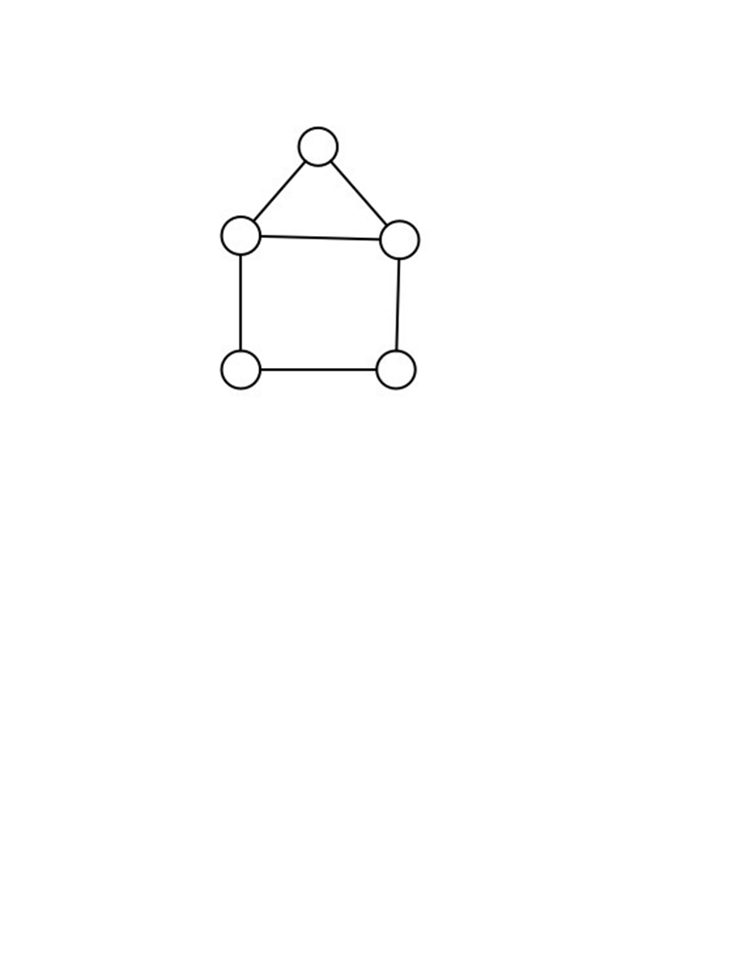
Graphs
Let G = (V, E) be a graph.
V is a set of vertices.
E is a set of edges, subset of V x V.

Slide 5
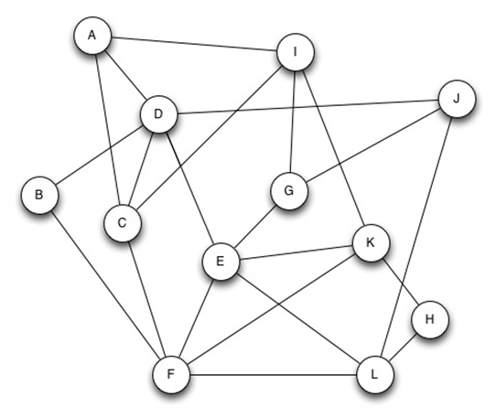
Some graphs are labeled

Slide 6
Some graphs have names!

Slide 7
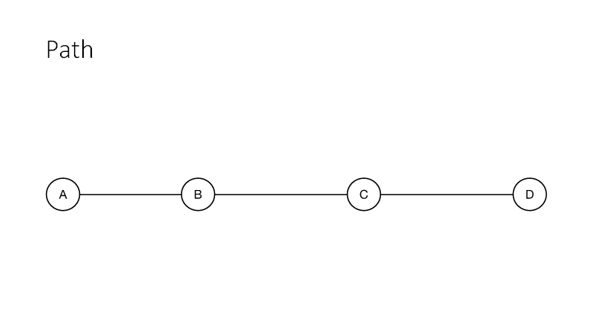

Slide 8
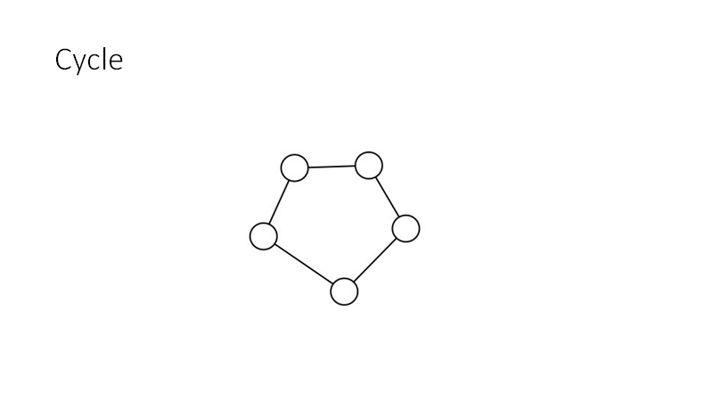

Slide 9
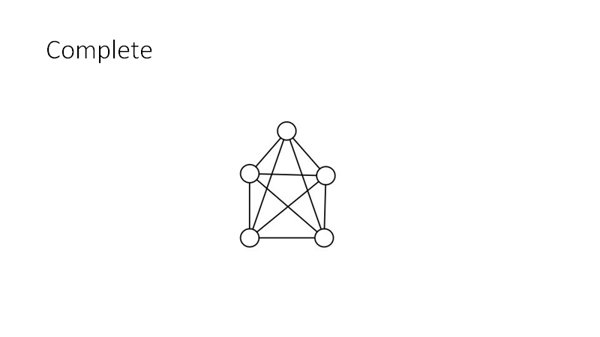

Slide 10
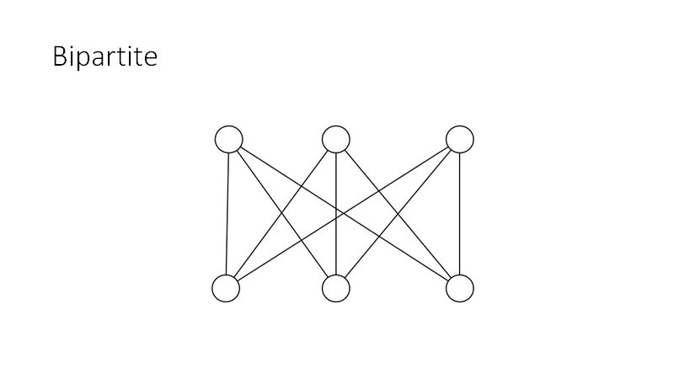

Slide 11
Some other terms:
Simple graph - a graph where a vertex cannot loop back to itself, and edges are bi-directional.
Connectivity - a graph is connected if every vertex is reachable from every other vertex.
Cycles - a cycle in a graph is a loop in a graph where no vertex is repeated except for the ending up where it started.
Degree - the degree of a vertex is the number of neighbors that vertex has.

Slide 12
How to represent these graphs in code?
When we need a graph structure in code, how do we represent them?
Two ways:
Adjacency matrix - a 2D list/array where each entry (i, j) represents a potential edge from vertex i to vertex j. If the edge exists, the entry will be 1, otherwise 0.
Adjacency list - a list structure (formally a linked list) where each entry in the list represents a vertex and holds a list itself. The entries in each sub-list are the adjacent vertices.
Adj. Matrix is good for dense graphs, lists are good for sparse.

Slide 13
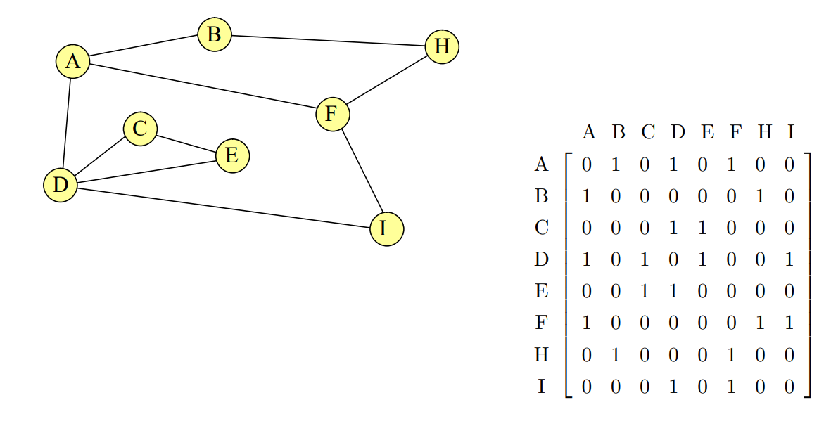
Adjacency Matrix Example

Slide 14
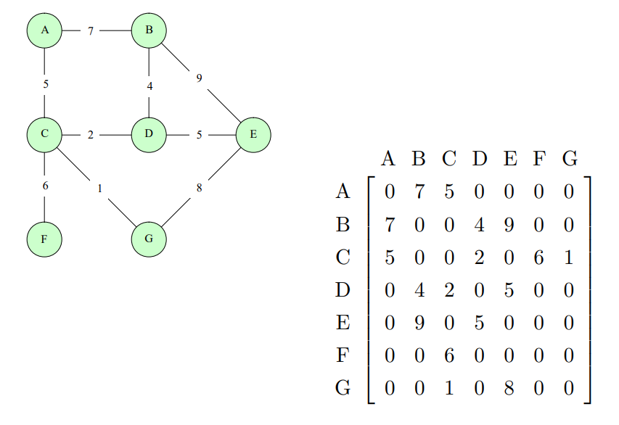
Weighted?

Slide 15
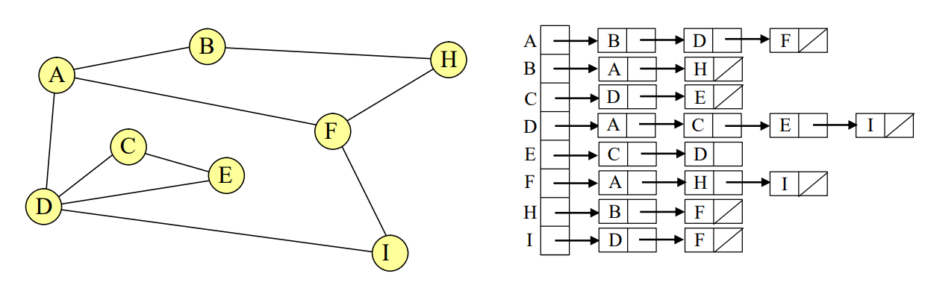
Adjacency List Example

Slide 16
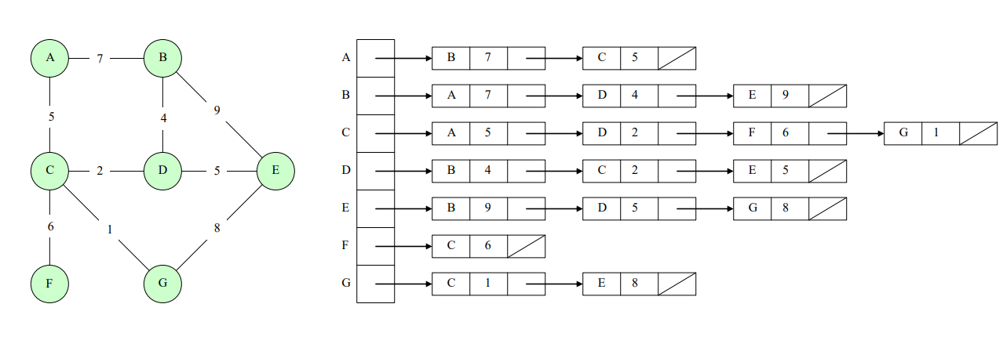
Weighted?

Slide 17
Traversal Recap
Two primary traversals - breadth-first search (BFS) and depth-first search (DFS)
Primarily used on trees, but can be used on general graphs as well.
DFS - follow a graph all the way to terminal or leaf vertices, then we pop up a level and keep going. Utilizes a stack-based data structure.
BFS - explore all of a level before moving on to the next level down. Utilizes a queue-based data structure.

Slide 18
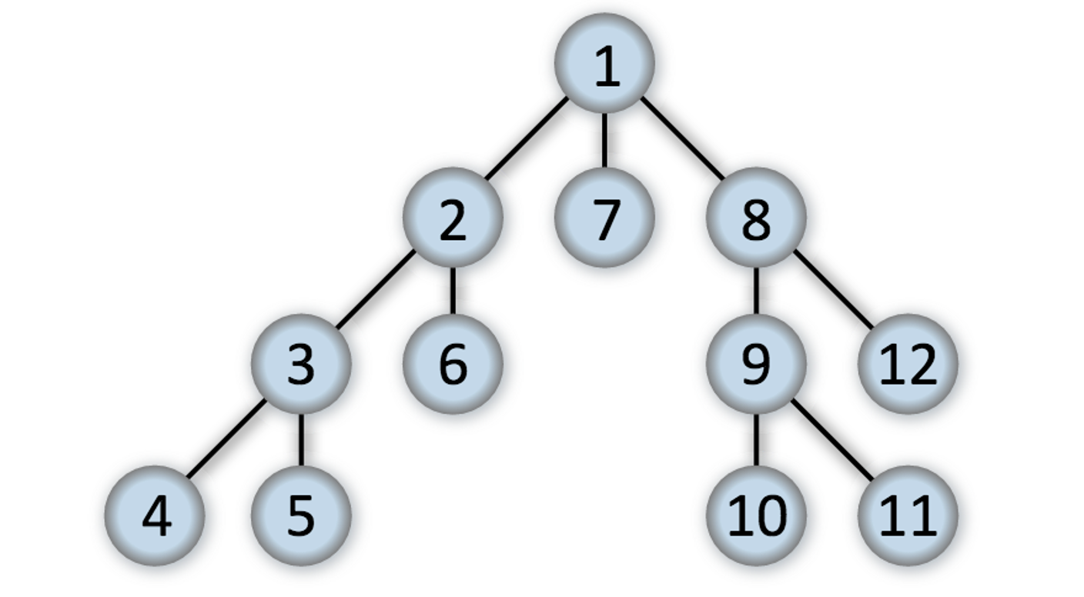
Quick example:
https://en.wikipedia.org/wiki/Depth-first_search#/media/File:Depth-first-tree.svg

Slide 19
Let’s examine DFS a bit closer:
function dfs(G): Input: G = (V, E) is a graph, v in V Output: visited(u) is set to true for all nodes u reachable from v for all v in V: visited(v) = false
for all v in V: if not visited(v): explore(G, v)
function explore(G, v): visited(v) = true previsit(v) for each edge (v,u) in E: if not visited(u): explore(G, u) postvisit(v)

Slide 20
Analysis?
function dfs(G): Input: G = (V, E) is a graph, v in V Output: visited(u) is set to true for all nodes u reachable from v for all v in V: visited(v) = false
for all v in V: if not visited(v): explore(G, v)
function explore(G, v): visited(v) = true previsit(v) for each edge (v,u) in E: if not visited(u): explore(G, u) postvisit(v)
Notes:
There’s a gotcha here - it looks like because we call explore for each v in V, and that explore has a loop, this should be n^2, but it’s not!

Slide 21
Pre/post visit numbers?
Good way to handle timings.
Previsit notes when the vertex is visited initially.
Postivisit notes when the vertex is visited for the last time.
function previsit(v): pre[v] = clock++ function postvisit(v): post[v] = clock++

Slide 22
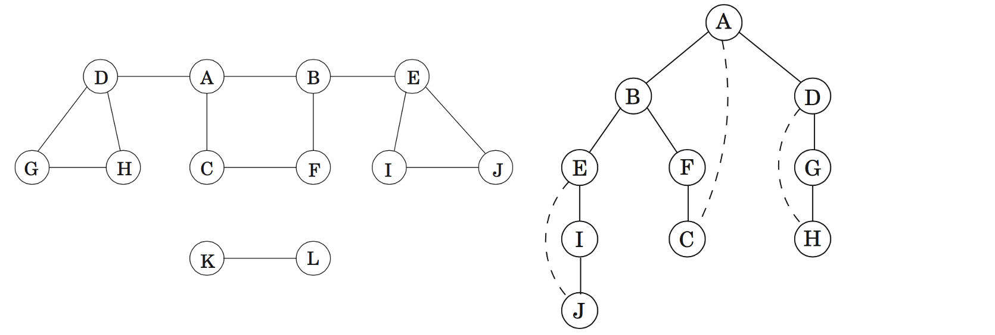
What happens in a general graph?
Notes:
Note that we typically go in “labelling” order - for code representations this is the vertex with the lowest number as stored in the list/matrix

Slide 23
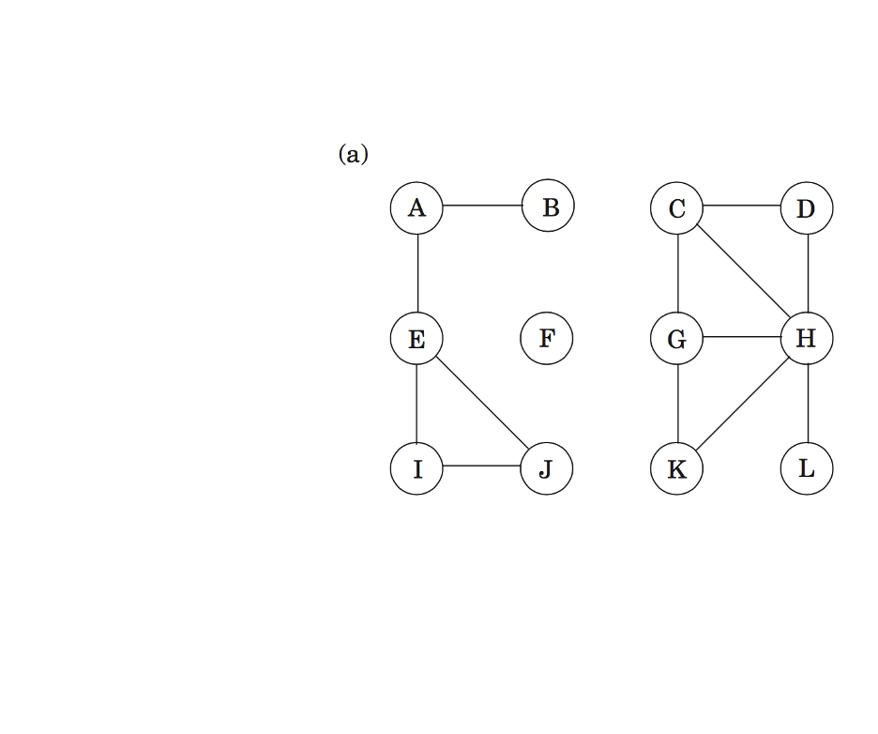
Now you:
Using the algorithm for DFS just noted (pg.s 84, 85 in Dasgupta), complete a depth-first traversal for the following graph, noting the pre/post visit numbers.
If you are in a breakout room and need help, use the “Ask for Help” functionality. If you are in a breakout room and finish the exercise, come right back to the main room!

Slide 24
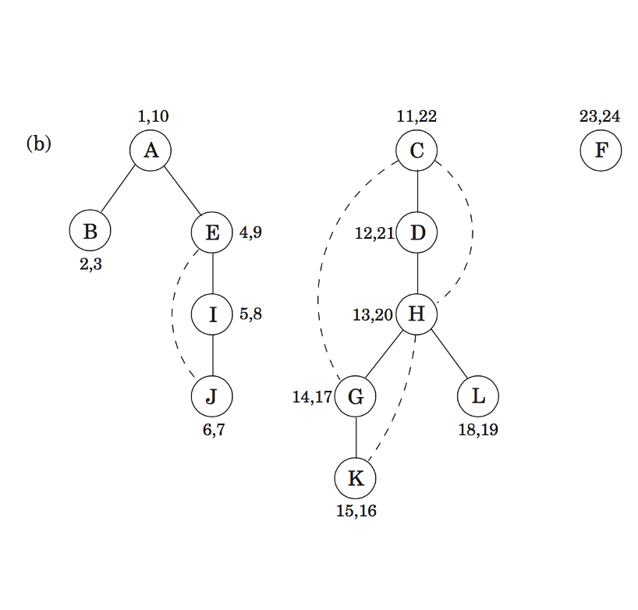
Solution:

Slide 25
So, connectivity?
A graph is connected iff you can trace a path from one vertex to every other vertex in our graph.
What do we notice about our DFS exercise?
DFS can detect connectivity easily.
Even better, it can identify strongly connected regions on directed graphs!
function previsit(v): pre[v] = clock++ ccnum[v] = cc

Slide 26
Let’s examine DFS a bit closer:
function dfs(G): Input: G = (V, E) is a graph, v in V Output: visited(u) is set to true for all nodes u reachable from v for all v in V: visited(v) = false
for all v in V: if not visited(v): explore(G, v), cc++
function explore(G, v): visited(v) = true previsit(v) for each edge (v,u) in E: if not visited(u): explore(G, u) postvisit(v)

Slide 27
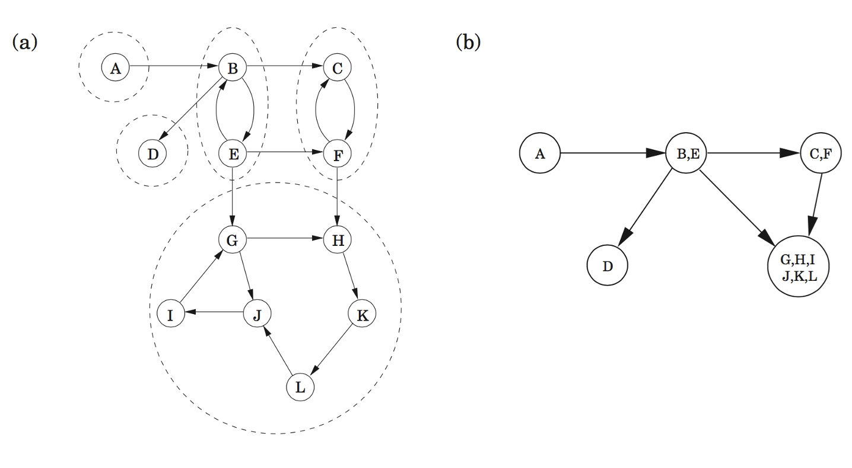
Strongly Connected Regions

Slide 28
Decomposition Algorithm
How do we find the strongly connected regions of a graph G? Through a decomposition algorithm. Utilizes two helper algorithms:
Run DFS on G^{R}. G^{R} is just the graph G with the edges reversed.
Run the undirected connected components adaptation of the DFS algorithm (pg. 86) on G and process vertices in decreasing order by the postvisit numbers from step 1. Each region identified will be a strongly connected region.
This algorithm requires you to run DFS twice!

Slide 29
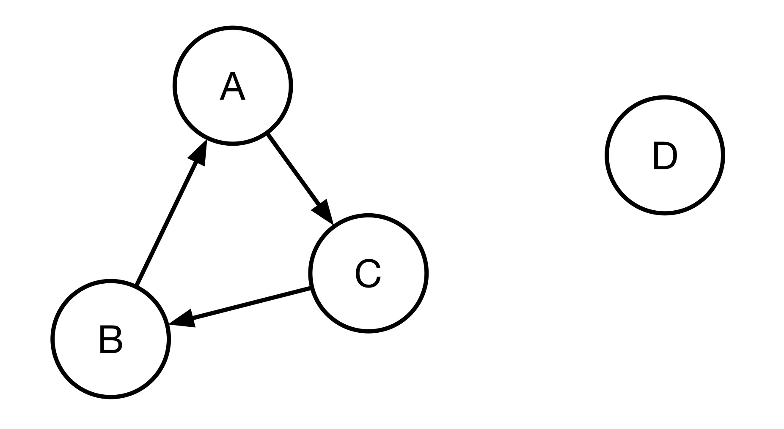
A quick? example:

Slide 30
Now you:
Run the strongly connected region algorithm on the diagram on page 91 (figure 3.9). Check your work!
If you are in a breakout room and need help, use the “Ask for Help” functionality. If you are in a breakout room and finish the exercise, come right back to the main room!

Slide 31
Analysis
This is two DFS calls, each O(|E|). So, overall this is O(|E|).
Or is it?
What about constructing G^{R}?

Slide 32
A design exercise:
(Dasgupta 3.5)
The reverse of a directed graph G = (V, E) is another directed graph GR = (V, ER) on the same vertex set, but with all the edges reversed: ER = {(v,u) : (u,v) E}.
Give a linear time algorithm for computing the reverse of a graph in adjacency list format.
First question: what do we mean by linear time here?

Slide 33
Let’s talk about proofs
(Dasgupta 3.7)
A bipartite graph is a graph G = (V, E) whose vertices can be partitioned into two sets (V = V₁ 𝖴 V₂ and V₁ ∩ V₂ = ∅) s.t. there are no edges between vertices in the same set.
One way to formulate this property is to say an undirected graph is bipartite iff if it contains no cycles of odd length. Prove that this formulation is correct.

Slide 34
On your radar:
Synthesis #1: due Friday
Homework #3: available now, due next week!
Reading: (Dasgupta) Chapters 3-5; (Goddard) D; (Skiena) Chapter 7, 8

